Slide 1

Bubble sort
Linear search
BINARY SEARCH
PPT PRESENTED
BY
POTUKANUMA JEEVITHA

Slide 2
Topics:
INTRODUCTION:
BUBBLE SORT—Example, Code, Output,
Advantages and Disadvantages
LINEAR SEARCH—Example, Code, Output,
Advantages and Disadvantages
BINARY SEARCH--Example, Code, Output,
Advantages and Disadvantages

Slide 3
INTRODUCTION
SEARCHING:
The definition of a search is the process of
looking for Something.

Slide 4
Bubble Sort
Bubble sort is a sorting algorithm that works by repeatedly stepping through lists that need to be sorted, comparing each pair of adjacent items and swapping them if they are in the wrong order. This passing procedure is repeated until no swaps are required, indicating that the list is sorted.

Slide 5
Example:
[7,1,3,8]→[1,7,3,8], Here, algorithm compares the first two elements, and swaps since
7 > 1.
[1,7,3,8]→[1,3,7,8], Here, again swap the numbers.
[1,3,7,8]→[1,3,7,8], Now the array is sorted.

Slide 6
CODE:
using System;
using System.Collections.Generic;
using System.Linq;
using System.Text;
using System.Threading.Tasks;
namespace BUBBLE_SORT
{
internal class Program
{
static void Main(string[] args)
{
int[] arr = new int[6] { 14, 30, 7, 8, 11, 3 };
bubblesort(arr, 6);
int a;
for (a = 0; a < 6; a++)
Console.Write(arr[a] + "\t");
Console.ReadLine();
}
//bubble sort
static void bubblesort(int[] data, int n)
{
int a;
int b;
for (a = 0; a < n; a++)
for (b = n - 1; b > a; b--)
if (data[b] < data[b - 1])
{
int temp = data[b];
data[b] = data[b - 1];
data[b - 1] = temp;
}
}
}
}

Slide 7
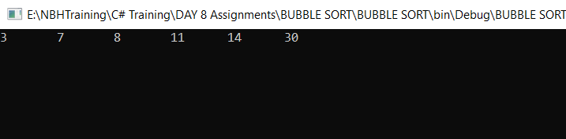
OUTPUT:

Slide 8
Advantages and Disadvantages of BS
Advantages:
Easy to understand.
Easy to implement.
In-place, no external memory is needed.
Performs greatly when the array is almost sorted.
Disadvantages:
It is highly inefficient for large data sets.
The amount of time it takes to sort.

Slide 9
Linear Search
Linear Search involves checking all the
elements of the array (or any other structure) one by one and in sequence until the desired result is found.

Slide 10
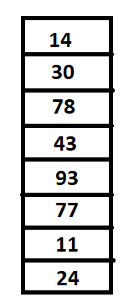
Example:
Start here
Find 20:
Every item is checked but no match is found Till the end of the data collection.
..Go through these, to the end.....
Stop here

Slide 11
Index 0
Find 78:
1
2
Found a match at index 2.
3
4
5
6
7

Slide 12
CODE:
using System;
using System.Collections.Generic;
using System.Linq;
using System.Text;
using System.Threading.Tasks;
namespace linear_search
{
internal class Search
{
static void Main(string[] args)
{
Search search = new Search();
int[] search_list = new int[] { 7, 8, 4, 2, 9, 6 };
int n, res;
Console.WriteLine("Enter a number to search: ");
n = Convert.ToInt32(Console.ReadLine());
res = search.LinearSearch(search_list, n);
if (res > 0)
Console.WriteLine("The target number " + n + " is found at Index " + res);
else
Console.WriteLine("Target Not Found");
Console.ReadLine();
}
int LinearSearch(int[] arr, int target)
{
for (int i = 0; i < arr.Length; i++)
{
if (target == arr[i])
return (i + 1);
}
return -1;
}
}
}

Slide 13
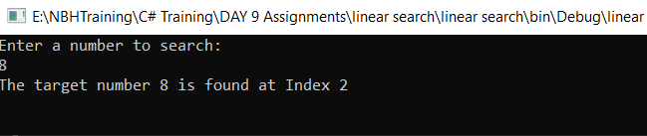
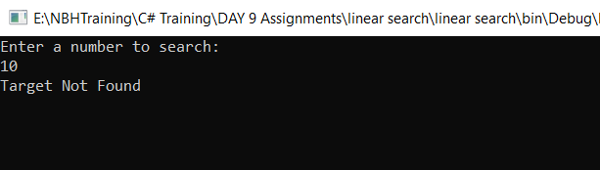
OUTPUT:

Slide 14
Advantages and Disadvantages
Advantages:
Easiest to understand and implement.
No sorting required.
Suitable for small list sizes.
Works fine for small number of elements.
Disadvantages:
Time inefficient as compared to other algorithms.
Not suitable for large-sized lists .

Slide 15
BINARY SEARCH
Binary search is the search technique that works efficiently on sorted lists. Hence, to search an element into some list using the binary search technique, we must ensure that the list is sorted.

Slide 16
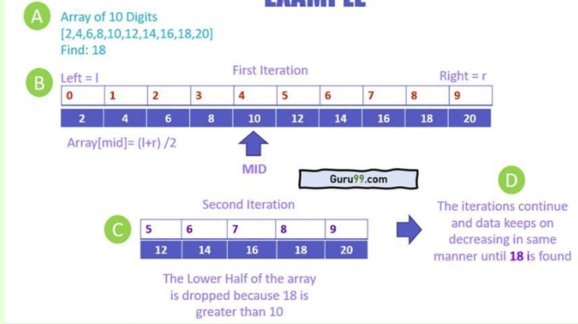
Example:

Slide 17
ADVANTAGES AND DISADVANTAGES
Advantages:
It eliminates half of the list from further searching by using the
result of each comparison.
It indicates whether the element being searched is before or after
the current position in the list
This information is used to narrow the search.
For large lists of data, it works significantly better than linear search.
Disadvantages:
It employs recursive approach which requires more stack space.
Programming binary search algorithm is error prone and difficult.
The interaction of binary search with memory hierarchy i.e.
caching is poor.

Slide 18


